Slide 1

Memory management
CE-2101 Algorithms and Data Structures

Slide 2
Disclaimer / Descargo de Responsabilidad
Esta presentación corresponde a una guía usada por el profesor durante las clases. La misma ha sido modificada para ser utilizado en el modelo de cursos asistidos por tecnología. No es una versión final, por lo que la misma podría requerir todavía hacer algunos ajustes. Para aspectos de evaluación esta presentación es solo una guía, por lo que el estudiante debe profundizar con el material de lectura asignado y lo discutido en clases para aspectos de evaluación.
This presentation corresponds to a guide material used by the professor during classes. It has been modified to be used in the model of technology-assisted courses. It is not a final version, so it may still require some adjustments. For evaluation aspects, this presentation is only a guide, so the student should delve with the assigned reading material and what has been discussed in class.

Slide 3

Before we begin...
What is the operating system?
What are the main functions of the operating system?

Slide 4
Before we begin...
An operating system is software. Is a software layer that sits on top of the hardware.
Main functions (top level):
Provide an API for developers that abstracts resources
Manage all the resources of the machine

Slide 5

Before we begin...
Main functions:
Process management
Memory management
File & Disk management
I/O management

Slide 6
Before we begin...
You’ll learn more about operating systems and memory management in CE-4303
For now, it is good to have a clear context of the topic before we begin
We will focus on memory management from the point of view of coding, but with an overview on how the OS manage it

Slide 7
Memory Management
What is memory management?
What involves memory management?
Take a guess, how does the OS manage the memory?

Slide 8
Memory Management
There have been different schemes or approaches on how to manage memory properly
These schemes have changed or evolve to meet more strict requirements, specially related to multiprogramming
Ranging from not memory management at all - just one bucket of memory - to the current concept of virtual memory

Slide 9
Memory Management
RAM memory is a valuable resource and it has to be handled carefully
Even though it is cheaper and more available than before
The part of the operating system that manage the memory is called memory manager.

Slide 10
Memory Management Schemes
No separation from physical memory
0xFFF...
Drivers in ROM
Operating system in RAM
User program
User program
User program
Operating system in RAM
Operating system in RAM
0x0

Slide 11
Memory Management Schemes
No separation from physical memory
0xFFF...
No abstraction, no transparency
Drivers in ROM
Operating system in RAM
User program
User program
User program
Operating system in RAM
Operating system in RAM
0x0

Slide 12
Memory Management Schemes
No separation from physical memory
0xFFF...
Drivers in ROM
Operating system in RAM
User program
User program
User program
Operating system in RAM
Operating system in RAM
0x0
How to do multiprogramming?

Slide 13
Memory Management Schemes
No separation from physical memory
0xFFF...
Drivers in ROM
Operating system in RAM
User program
User program
Static relocation!
User program
Operating system in RAM
Operating system in RAM
0x0
How to do multiprogramming?

Slide 14
Memory Management Schemes
In time there were new schemes to manage memory:
Address spaces: Each program gets a section of the memory assigned to itself and no one else
Base and limit registers
Dynamic relocation
Swapping for multiprogramming

Slide 15
Memory Management Schemes
In time there were new schemes to manage memory:
Address spaces: Each program gest a section of the memory assigned to itself and no one else
Base and limit registers
Dynamic relocation
Swapping for multiprogramming
In this approach the complete program had to be on memory
The size of the programs is increasing

Slide 16

Memory Management Schemes
How can a program of 2 GB run in a computer with only 512 MB of RAM?

Slide 17
Memory Management Schemes
Virtual memory: Each program has its memory space which is separated in pages of fixed size.
Each page is a small range of memory addresses.
The program does memory operations transparently

Slide 18
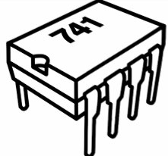
Memory Management Schemes
Virtual Memory
Physical Memory
0xFFFFFFFF
Read 0xAB84DC64
Page 2
...
Page 6
MMU
User program
0x445E6DCC
Page 3
f(x)
...
Page 5
0x00000000

Slide 19
Memory Management Schemes
Virtual Memory
Physical Memory
0xFFFFFFFF
Read 0xAB84DC64
Page 2
...
Page 6
MMU
User program
0x445E6DCC
Page 3
f(x)
...
Page 5
0x00000000
What if the address is in page 1?

Slide 20
Memory Management Schemes
Virtual Memory
Physical Memory
0xFFFFFFFF
Read 0xAB84DC64
Page 2
...
Page 6
MMU
User program
0x445E6DCC
Page 3
f(x)
...
Page 5
0x00000000
What if the address is in page 1?
Page fault!

Slide 21
Memory Management Schemes
CPU sends virtual addresses to the MMU
CPU Package
Memory
Disk Controller
CPU
MMU
Bus
MMU sends physical addresses to the memory

Slide 22
Memory Management
CPU
Execute Program
OS
Cache Fault/miss
Hard
drive
User Space
Cache
Page Fault
Cache Hit
Memory

Slide 23
Memory management: program level
We’ve seen a quick overview of how memory is managed at OS level.
Let’s focus on memory management from the program’s point of view

Slide 24

Memory management: program level
We’ve seen a quick overview of how memory is managed at OS level.
Let’s focus on memory management from the program’s point of view
Why are we learning about memory in a data structures course?!

Slide 25
Memory management: program level
We’ve seen a quick overview of how memory is managed at OS level.
Let’s focus on memory management from the program’s point of view
Why are we learning about memory in a data structures course?!
Even the most elegant and efficient data structure can be disempowered if memory is handled wrong

Slide 26
Memory management: program level
How is the memory of a program structured?
What is the heap?
What is the stack?
Pointers? References?

Slide 27
Memory management: program level
A program in execution (process) has a well known structure for its memory
This memory layout may vary depending on the programming language, but it is similar conceptually
Let's see how look the memory layout of a C program when its running

Slide 28
Memory management: program level
High address
Command-line args and environment variables
Stack
Heap
Unintialized data (bss)
Initialized data
Text
Low address

Slide 29
Memory management: program level
High address
Command-line args and environment variables
Stack
Only one copy for all running programs
Heap
Unintialized data (bss)
Instructions of the program (code)
Initialized data
Text
Low address

Slide 30
Memory management: program level
High address
Command-line args and environment variables
Stack
Heap
Unintialized data
Initialized global variables
Initialized data
Text
Low address

Slide 31
Memory management: program level
High address
Command-line args and environment variables
Stack
Heap
Uninitialized global variables
Static Allocated Variables
Unintialized data
Initialized data
Text
Low address

Slide 32
Memory management: program level
High address
Parameters passed from command line and env. var
Command-line args and environment variables
Stack
Heap
Unintialized data
Initialized data
Text
Low address

Slide 33
Memory management: program level
High address
Command-line args and environment variables
More on this later
Stack
Heap
Unintialized data
Initialized data
Text
Low address

Slide 34
Memory management: program level
High address
Command-line args and environment variables
Stack
More on this later
Heap
Unintialized data
Initialized data
Text
Low address

Slide 35
Memory management: program level
High address
Command-line args and environment variables
Stack
Growing direction
Heap
Unintialized data
Initialized data
Text
Low address

Slide 36
Memory management: program level
High address
Command-line args and environment variables
Stack
Bad things happen if these two cross each other
Heap
Unintialized data
Initialized data
Text
Low address

Slide 37
Stack
Its a section of the memory layout. Behaves in LIFO just like any given stack
It is composed of a set of stack frames. Each frame is a function call
When a function is called, a new stack frame is inserted in the stack
When a function returns, a stack frame gets removed

Slide 38
Stack
Its a section of the memory layout. Behaves in LIFO just like any given stack
It is composed of a set of stack frames. Each frame is a function call
When a function is called, a new stack frame is inserted in the stack
When a function returns, a stack frame gets removed
What about recursive calls?

Slide 39
Stack
Each stack frame contains at least the following elements:
Storage space for all automatic variables for the new called function
Line number of the calling function (where to return)
Arguments or parameters of the called function

Slide 40
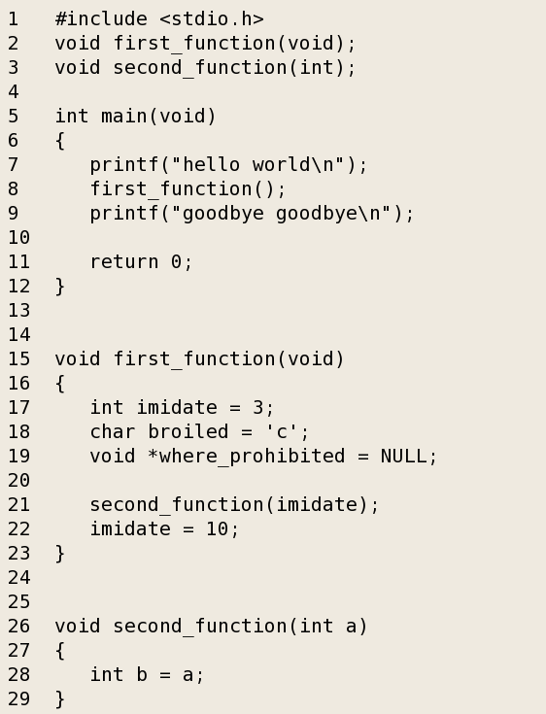
Stack
Stack

Slide 41
Stack
Stack
main

Slide 42
Stack
Stack
main
first_function
Return to main, line 9
Storage for an int
Storage for a char
Storage for a void *

Slide 43
Stack
Stack
main
first_function
Return to main, line 9
Storage for an int
Storage for a char
Storage for a void *
second_function
Return to first_function, line 22
Storage for an int
Storage for an int parameter

Slide 44
Stack
Stack
main
first_function
Return to main, line 9
Storage for an int
Storage for a char
Storage for a void *

Slide 45
Stack
Stack
main

Slide 46
Stack
The stack is your friend, it manages the memory for you! It is transparent to the programmer!
When a stack frame is popped from the stack, all the storage is automatically freed
There is a well-known limit on variable size
Variable scoping can help you understand how the stack works

Slide 47
Heap
Section of a process memory layout
It is not managed automatically, you must be careful when dealing with it.
The programmer has to interact directly with the heap
Allocate memory
Deallocate/free memory
Resize memory

Slide 48
Heap
How does the programmer "talks" with the heap?
The programming language provides an API for this. For example in C you have:
malloc
calloc
realloc
free

Slide 49

Heap
Can I avoid using the heap?
Sure you can!
Some programming languages don't allow the programmer to interact with the heap
The caveat:
No interesting data structures!
You will be very restricted on what you can do

Slide 50
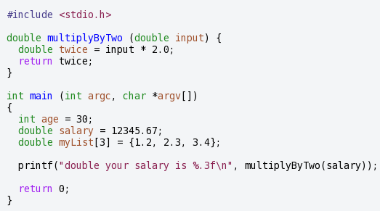
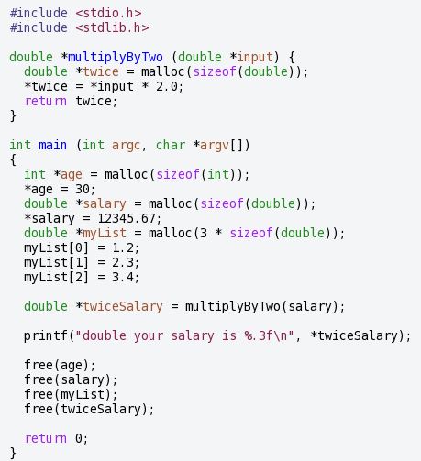
Heap

Slide 51
Heap
No using heap
Using the heap

Slide 52
Heap
1 2 3 4 5 6 7 8 9 10 11 12 13 14 15 16 17 18 19 20 21 22 23 | int main (int argc, char *argv[]) { int *age = malloc(sizeof(int)); *age = 30; double *salary = malloc(sizeof(double)); *salary = 12345.67; double *myList = malloc(3 * sizeof(double)); myList[0] = 1.2; myList[1] = 2.3; myList[2] = 3.4; double *twiceSalary = multiplyByTwo(salary); printf("double your salary is %.3f\n", *twiceSalary); free(age); free(salary); free(myList); free(twiceSalary); return 0; }
Heap
0x0000
storage for an int (age)

Slide 53
Heap
1 2 3 4 5 6 7 8 9 10 11 12 13 14 15 16 17 18 19 20 21 22 23 | int main (int argc, char *argv[]) { int *age = malloc(sizeof(int)); *age = 30; double *salary = malloc(sizeof(double)); *salary = 12345.67; double *myList = malloc(3 * sizeof(double)); myList[0] = 1.2; myList[1] = 2.3; myList[2] = 3.4; double *twiceSalary = multiplyByTwo(salary); printf("double your salary is %.3f\n", *twiceSalary); free(age); free(salary); free(myList); free(twiceSalary); return 0; }
Heap
0x0010
storage for a double (salary)
0x0000
storage for an int (age)

Slide 54
Heap
1 2 3 4 5 6 7 8 9 10 11 12 13 14 15 16 17 18 19 20 21 22 23 | int main (int argc, char *argv[]) { int *age = malloc(sizeof(int)); *age = 30; double *salary = malloc(sizeof(double)); *salary = 12345.67; double *myList = malloc(3 * sizeof(double)); myList[0] = 1.2; myList[1] = 2.3; myList[2] = 3.4; double *twiceSalary = multiplyByTwo(salary); printf("double your salary is %.3f\n", *twiceSalary); free(age); free(salary); free(myList); free(twiceSalary); return 0; }
Heap
0x0068
storage for a double ( myList[2] )
0x0048
storage for a double ( myList[1] )
0x0040
storage for a double ( myList[0] )
0x0020
storage for a double (salary)
0x0000
storage for an int (age)

Slide 55
Heap
1 2 3 4 5 6 7 8 9 10 11 12 13 14 15 16 17 18 19 20 21 22 23 | int main (int argc, char *argv[]) { int *age = malloc(sizeof(int)); *age = 30; double *salary = malloc(sizeof(double)); *salary = 12345.67; double *myList = malloc(3 * sizeof(double)); myList[0] = 1.2; myList[1] = 2.3; myList[2] = 3.4; double *twiceSalary = multiplyByTwo(salary); printf("double your salary is %.3f\n", *twiceSalary); free(age); free(salary); free(myList); free(twiceSalary); return 0; }
Heap
0x0088
storage for a double (twiceSalary)
0x0068
storage for a double ( myList[2] )
0x0048
storage for a double ( myList[1] )
0x0040
storage for a double ( myList[0] )
0x0020
storage for a double (salary)
0x0000
storage for an int (age)

Slide 56
Heap
1 2 3 4 5 6 7 8 9 10 11 12 13 14 15 16 17 18 19 20 21 22 23 | int main (int argc, char *argv[]) { int *age = malloc(sizeof(int)); *age = 30; double *salary = malloc(sizeof(double)); *salary = 12345.67; double *myList = malloc(3 * sizeof(double)); myList[0] = 1.2; myList[1] = 2.3; myList[2] = 3.4; double *twiceSalary = multiplyByTwo(salary); printf("double your salary is %.3f\n", *twiceSalary); free(age); free(salary); free(myList); free(twiceSalary); return 0; }
Heap
Does malloc under the covers
0x0088
storage for a double (twiceSalary)
0x0068
storage for a double ( myList[2] )
0x0048
storage for a double ( myList[1] )
0x0040
storage for a double ( myList[0] )
0x0020
storage for a double (salary)
0x0000
storage for an int (age)

Slide 57
Heap
1 2 3 4 5 6 7 8 9 10 11 12 13 14 15 16 17 18 19 20 21 22 23 | int main (int argc, char *argv[]) { int *age = malloc(sizeof(int)); *age = 30; double *salary = malloc(sizeof(double)); *salary = 12345.67; double *myList = malloc(3 * sizeof(double)); myList[0] = 1.2; myList[1] = 2.3; myList[2] = 3.4; double *twiceSalary = multiplyByTwo(salary); printf("double your salary is %.3f\n", *twiceSalary); free(age); free(salary); free(myList); free(twiceSalary); return 0; }
Heap
0x0088
storage for a double (twiceSalary)
0x0068
storage for a double ( myList[2] )
0x0048
storage for a double ( myList[1] )
0x0040
storage for a double ( myList[0] )
0x0020
storage for a double (salary)

Slide 58
Heap
1 2 3 4 5 6 7 8 9 10 11 12 13 14 15 16 17 18 19 20 21 22 23 | int main (int argc, char *argv[]) { int *age = malloc(sizeof(int)); *age = 30; double *salary = malloc(sizeof(double)); *salary = 12345.67; double *myList = malloc(3 * sizeof(double)); myList[0] = 1.2; myList[1] = 2.3; myList[2] = 3.4; double *twiceSalary = multiplyByTwo(salary); printf("double your salary is %.3f\n", *twiceSalary); free(age); free(salary); free(myList); free(twiceSalary); return 0; }
Heap
0x0088
storage for a double (twiceSalary)
0x0068
storage for a double ( myList[2] )
0x0048
storage for a double ( myList[1] )
0x0040
storage for a double ( myList[0] )
0x0020
storage for a double (salary)

Slide 59
Heap
1 2 3 4 5 6 7 8 9 10 11 12 13 14 15 16 17 18 19 20 21 22 23 | int main (int argc, char *argv[]) { int *age = malloc(sizeof(int)); *age = 30; double *salary = malloc(sizeof(double)); *salary = 12345.67; double *myList = malloc(3 * sizeof(double)); myList[0] = 1.2; myList[1] = 2.3; myList[2] = 3.4; double *twiceSalary = multiplyByTwo(salary); printf("double your salary is %.3f\n", *twiceSalary); free(age); free(salary); free(myList); free(twiceSalary); return 0; }
Heap
0x0088
storage for a double (twiceSalary)
0x0068
storage for a double ( myList[2] )
0x0048
storage for a double ( myList[1] )
0x0040
storage for a double ( myList[0] )
0x0020
storage for a double (salary)

Slide 60
Heap
1 2 3 4 5 6 7 8 9 10 11 12 13 14 15 16 17 18 19 20 21 22 23 | int main (int argc, char *argv[]) { int *age = malloc(sizeof(int)); *age = 30; double *salary = malloc(sizeof(double)); *salary = 12345.67; double *myList = malloc(3 * sizeof(double)); myList[0] = 1.2; myList[1] = 2.3; myList[2] = 3.4; double *twiceSalary = multiplyByTwo(salary); printf("double your salary is %.3f\n", *twiceSalary); free(age); free(salary); free(myList); free(twiceSalary); return 0; }
Heap

Slide 61
Heap
1 2 3 4 5 6 7 8 9 10 11 12 13 14 15 16 17 18 19 20 21 22 23 | int main (int argc, char *argv[]) { int *age = malloc(sizeof(int)); *age = 30; double *salary = malloc(sizeof(double)); *salary = 12345.67; double *myList = malloc(3 * sizeof(double)); myList[0] = 1.2; myList[1] = 2.3; myList[2] = 3.4; double *twiceSalary = multiplyByTwo(salary); printf("double your salary is %.3f\n", *twiceSalary); free(age); free(salary); //free(myList); free(twiceSalary); return 0; }
Heap
What if I forget to free some storage?
0x0068
storage for a double ( myList[2] )
0x0048
storage for a double ( myList[1] )
0x0040
storage for a double ( myList[0] )
0x0020
storage for a double (salary)

Slide 62
Heap
1 2 3 4 5 6 7 8 9 10 11 12 13 14 15 16 17 18 19 20 21 22 23 | int main (int argc, char *argv[]) { int *age = malloc(sizeof(int)); *age = 30; double *salary = malloc(sizeof(double)); *salary = 12345.67; double *myList = malloc(3 * sizeof(double)); myList[0] = 1.2; myList[1] = 2.3; myList[2] = 3.4; double *twiceSalary = multiplyByTwo(salary); printf("double your salary is %.3f\n", *twiceSalary); free(age); free(salary); //free(myList); free(twiceSalary); return 0; }
Heap
That, my friend, is a memory leak!
What if I forget to free some storage?
0x0068
storage for a double ( myList[2] )
0x0048
storage for a double ( myList[1] )
0x0040
storage for a double ( myList[0] )
0x0020
storage for a double (salary)

Slide 63
Heap

Slide 64
Heap
Thats a nice empty heap!

Slide 65
Heap
Total Size

Slide 66
Heap
After a couple of malloc / free
This color means free memory
This color means allocated memory

Slide 67
Heap
In this scenario, memory becomes fragmented
What if there's a need for three contiguous blocks of memory?

Slide 68

Heap
The operating system "burps" or compacts the memory
Memory "holes" scattered in the memory space are merged
Its an expensive operation

Slide 69
Heap
Now there's space for more stuff

Slide 70
Heap or stack?
Choose the right tool for your needs
Use the heap if:
Need to allocate large block of memory (large arrays / structs)
Need to keep the variable a long time
Need to create a structure that grows dynamically

Slide 71
Heap or stack?
Use the stack if:
Need only small variables of well-known types
You know that the variables will not grow dynamically
Need persist variable only in the scope that they are being used
This decision will be easier in time.

Slide 72
Heap or stack?
Heap memory | Stack or local memory
Lifetime: the programmer controls when the memory is allocated and deallocated. Is possible to build data structures and return them to the caller Size: the size of the allocated memory can be controlled | Convenient: temporary independent memory Efficient: time and space efficient Local copies: avoid collateral damages
More work: is the programmer responsibility to handle the memory More bugs: the programmer can leave leaks or make mistakes | Short lifetime: only exists in a specific scope. The life span is very strict. Restricted communication: cannot communicate with the caller from the callee

Slide 73

Memory management in C/C++
What is a pointer?
How can I manipulate memory in C/C++?

Slide 74

Pointers
There are many things that can only be done with pointers
Is one of the most powerful features of C, but one of the most feared
With pointers the programmer can manipulate memory

Slide 75
Pointers
When a variable is declared, memory is assigned to it.
With the variable name is possible to write or read the value in memory
int counter = 5;
0x000A
counter
5

Slide 76
Pointers
A pointer works very different. It doesn't store the value directly, it just points to it.
A pointer stores a reference to another value. It stores the memory address of a value in memory
counter
5
counterPtr
0x000A

Slide 77
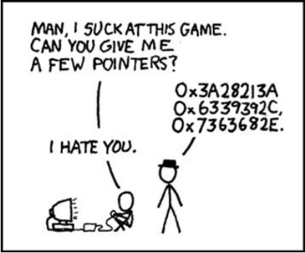
Pointers

Slide 78
Pointers
A pointer in C is a special data type:
int*
double*
char*
<struct>*
void*
and many more…
When a pointer is declared, memory is allocated for it. But how much memory?

Slide 79
Pointers
By the way, this is how you declare a pointer...
1 2 3 4 5 6 7 8 | int main (int argc, char *argv[]) { int* age; char* charPtr = &p; void* nothingPtr; return 0; }

Slide 80
Pointers
1 2 3 4 5 6 7 8 | int main (int argc, char *argv[]) { int* age; char* charPtr; void* nothingPtr; return 0; }
Just like any other variable, pointer need space
This reads: pointer to int, pointer to char, pointer to void

Slide 81
Pointers
1 2 3 4 5 6 7 8 | int main (int argc, char *argv[]) { int* age; char* charPtr; void* nothingPtr; return 0; }
Take a guess, how many bytes are assigned to each variable?

Slide 82
Pointers
Any pointer variable takes the same amount of space: an integer.
So, what is the point of specifying a type to the pointer?
Specifying a type for a pointer is giving a hint of the type of data that it points to

Slide 83
Pointers
Any pointer variable takes the same amount of space: an integer.
So, what is the point of specifying a type to the pointer?
Specifying a type for a pointer is giving a hint of the type of data that it points to
How is this helpful?

Slide 84
Pointers
Any pointer variable takes the same amount of space: an integer.
So, what is the point of specifying a type to the pointer?
Specifying a type for a pointer is giving a hint of the type of data that it points to
For error checking
For error checking
To know how many bytes read later

Slide 85
Pointers
A pointer normally is used to deal with variables in the heap, but it can also be used in the stack
To assign a value to a pointer, you need to use the & operator (reference operator)
To get the value pointed by a pointer, use the * operator

Slide 86
Pointers
A pointer normally is used to deal with variables in the heap, but it can also be used in the stack
To assign a value to a pointer, you need to use the & operator (reference operator)
To get the value pointed by a pointer, use the * operator
What do you think of this?

Slide 87
Pointers
A pointer normally is used to deal with variables in the heap, but it can also be used in the stack
To assign a value to a pointer, you need to use the & operator (reference operator)
To get the value pointed by a pointer, use the * operator
What do you think of this?

Slide 88
Pointers
What is the default value of a pointer variable?
A pointer variable is initialized with a “bad value” a random address
Always initialize your pointers!

Slide 89
Pointers
A pointer can be assigned with the special value NULL
The idea is “points to nothing”
NULL is equal to 0 ¿Why is this important?
Dereferencing a NULL pointer causes a runtime error

Slide 90
Pointers: The & Operator
There are different ways to set a value to a pointer variable
The most common way is using the & operator
1 2 3 4 5 6 7 | int main (int argc, char *argv[]) { int data = 55; int* dataPtr = &data; return 0; }

Slide 91
Pointers: The & Operator
There are different ways to set a value to a pointer variable
The most common way is using the & operator
1 2 3 4 5 6 7 | int main (int argc, char *argv[]) { int data = 55; int* dataPtr = &data; return 0; }
Retrieves the address of the data variable and assigns it to dataPtr

Slide 92
Pointers: The * operator
How can I get the data pointed by a pointer?
Use the * operator. This unary operator goes on the left of a pointer variable and retrieves the data that it points to
This operator dereferences a pointer
Never dereference a pointer with no value!

Slide 93
Pointers: The * operator
1 2 3 4 5 6 7 8 9 10 11 | int main (int argc, char *argv[]) { int data = 55; int* dataPtr = &data; printf(data); printf(dataPtr); printf(*dataPtr) return 0; }

Slide 94
Pointers: The * operator
1 2 3 4 5 6 7 8 9 10 11 | int main (int argc, char *argv[]) { int data = 55; int* dataPtr = &data; printf(data); printf(dataPtr); printf(*dataPtr) return 0; }
What’s displayed on the console?

Slide 95
Pointers: The * operator
1 2 3 4 5 6 7 8 9 10 11 | int main (int argc, char *argv[]) { int data = 55; int* dataPtr = &data; printf(data); printf(dataPtr); printf(*dataPtr) return 0; }
> 55
> 0x0032AACC
> 55

Slide 96
Pointers: Sharing
What is sharing?
Having more than one pointers pointing to the same data
counter
5
counterPtr
0x000A
counterPtr_2
0x000A

Slide 97
Pointers: Sharing
1 2 3 4 5 6 7 8 9 10 11 12 | int main (int argc, char *argv[]) { int data; int* dataPtr; int* dataPtr_2; data = 256; dataPtr = &data; dataPtr_2 = &data; return 0; }
Both point to the same data

Slide 98
Pointers: Sharing
1 2 3 4 5 6 7 8 9 10 11 12 | int main (int argc, char *argv[]) { int data; int* dataPtr; int* dataPtr_2; data = 256; dataPtr = &data; dataPtr_2 = dataPtr; return 0; }
Assigning a pointer to another just copies the address not the data!

Slide 99
Pointer: Shallow and deep copying
Shallow copy means just copying the references not the data:
counterPtr
0x000A
5
counterPtr_2
0x000A

Slide 100
Pointer: Shallow and deep copying
Deep copy means also copying the data:
counterPtr
0x000A
5
counterPtr_2
0x000B
5

Slide 101
Pointer: Shallow and deep copying
Deep copy means also copying the data:
counterPtr
0x000A
5
5
counterPtr_2
0x000B
5
Notice it is a different address!

Slide 102
Pointer: Shallow and deep copying
To do a deep copy you may need to use the memcpy, strcpy, or similar.
In some cases it can even need more work, like copying an array or a complex structure

Slide 103
Pointer: Shallow and deep copying
1 2 3 4 5 6 7 8 9 10 11 12 13 14 15 | int main (int argc, char *argv[]) { int value = 5; int *pointer = &value; int *pointer2; //Shallow copy pointer2 = pointer; //Deep copy pointer2 = malloc(sizeof(int)); *pointer2 = *pointer; return 0; }

Slide 104
Pointers: Arrays and arithmetics
Declaring an array using an expression like int vec[5]; is allocating a contiguous block of memory
The vec variable is a pointer to the first element of the array
vec
0x0900
0x0900 | vec[0]
0x9001 | vec[1]
0x9002 | vec[2]
0x9003 | vec[3]
0x9004 | vec[4]

Slide 105
Pointers: Arrays and arithmetics
Accessing each of the array entry (vec[0], vec[1]...vec[4]) really is pointers arithmetic
Stepping into the array memory n number of times

Slide 106
Pointers: Arrays and arithmetics
1 2 3 4 5 6 7 8 9 10 | int main(void) { int *vec; vec = malloc(sizeof(int) * 3); vec[0] = 1; vec[1] = 2; vec[2] = 3; printf("vec[2]=%d\n", *(vec+2)); free(vec); return 0; }

Slide 107
Pointers: Arrays and arithmetics
1 2 3 4 5 6 7 8 9 10 11 | int main(void) { int *vec; int i; vec = malloc(sizeof(int) * 3); for (i = 0; i < 2; i++) { printf(*(vec+i)); } return 0; }

Slide 108
Pointers: examples
1 2 3 4 5 6 7 8 9 10 11 12 13 14 | int main (int argc, char *argv[]) { int data = 5; int *pointer = &data; int *pointer2 = pointer; int data2 = data; int data3 = *pointer2; int **pointerPointer = &pointer; data = 8; return 0; }
0x9000 | 5 | data
0x9001
0x9002
0x9003
0x9004
0x9005
0x9006
0x9007
0x9008

Slide 109
Pointers: examples
1 2 3 4 5 6 7 8 9 10 11 12 13 14 | int main (int argc, char *argv[]) { int data = 5; int *pointer = &data; int *pointer2 = pointer; int data2 = data; int data3 = *pointer2; int **pointerPointer = &pointer; data = 8; return 0; }
0x9000 | 5 | data
0x9001 | 0x9000 | pointer
0x9002
0x9003
0x9004
0x9005
0x9006
0x9007
0x9008

Slide 110
Pointers: examples
1 2 3 4 5 6 7 8 9 10 11 12 13 14 | int main (int argc, char *argv[]) { int data = 5; int *pointer = &data; int *pointer2 = pointer; int data2 = data; int data3 = *pointer2; int **pointerPointer = &pointer; data = 8; return 0; }
0x9000 | 5 | data
0x9001 | 0x9000 | pointer
0x9002 | 0x9000 | pointer2
0x9003
0x9004
0x9005
0x9006
0x9007
0x9008

Slide 111
Pointers: examples
1 2 3 4 5 6 7 8 9 10 11 12 13 14 | int main (int argc, char *argv[]) { int data = 5; int *pointer = &data; int *pointer2 = pointer; int data2 = data; int data3 = *pointer2; int **pointerPointer = &pointer; data = 8; return 0; }
0x9000 | 5 | data
0x9001 | 0x9000 | pointer
0x9002 | 0x9000 | pointer2
0x9003 | 5 | data2
0x9004
0x9005
0x9006
0x9007
0x9008

Slide 112
Pointers: examples
1 2 3 4 5 6 7 8 9 10 11 12 13 14 | int main (int argc, char *argv[]) { int data = 5; int *pointer = &data; int *pointer2 = pointer; int data2 = data; int data3 = *pointer2; int **pointerPointer = &pointer; data = 8; return 0; }
0x9000 | 5 | data
0x9001 | 0x9000 | pointer
0x9002 | 0x9000 | pointer2
0x9003 | 5 | data2
0x9004 | 5 | data3
0x9005
0x9006
0x9007
0x9008

Slide 113
Pointers: examples
1 2 3 4 5 6 7 8 9 10 11 12 13 14 | int main (int argc, char *argv[]) { int data = 5; int *pointer = &data; int *pointer2 = pointer; int data2 = data; int data3 = *pointer2; int **pointerPointer = &pointer; data = 8; return 0; }
0x9000 | 5 | data
0x9001 | 0x9000 | pointer
0x9002 | 0x9000 | pointer2
0x9003 | 5 | data2
0x9004 | 5 | data3
0x9005 | 0x9001 | pointerPointer
0x9006
0x9007
0x9008

Slide 114
Pointers: examples
1 2 3 4 5 6 7 8 9 10 11 12 13 14 | int main (int argc, char *argv[]) { int data = 5; int *pointer = &data; int *pointer2 = pointer; int data2 = data; int data3 = *pointer2; int **pointerPointer = &pointer; data = 8; return 0; }
0x9000 | 8 | data
0x9001 | 0x9000 | pointer
0x9002 | 0x9000 | pointer2
0x9003 | 5 | data2
0x9004 | 5 | data3
0x9005 | 0x9001 | pointerPointer
0x9006
0x9007
0x9008

Slide 115
Pointers: examples
1 2 3 4 5 6 7 | void swap(int *px, int *py) { int temp; temp = *px; *px = *py; *py = temp; }
pointer1
0x000A
30
pointer2
0x000B
45
swap
pointer1
0x000A
45
pointer2
0x000B
30

Slide 116
Pointers: examples
1 2 3 4 5 | int* foo() { int temp = 5; return &temp; }
What do you think of this code?

Slide 117
References
The term reference means almost the same thing as the word "pointer"
Sometimes pointer is used more in a C/C++ context and reference for other languages
Also reference is used more on the context of parameter passing. More on this later.

Slide 118
References
Also C++ supports the reference data type:
1 2 3 4 5 6 7 8 9 | int main() { int temp = 25; int& reference = temp; printf(reference); return 0; }

Slide 119
References
Also C++ supports the reference data type:
Implicit & operation to get the address
1 2 3 4 5 6 7 8 9 | int main() { int temp = 25; int& reference = temp; printf(reference); return 0; }
Implicit * operation to get the value pointed
An Alias for temp

Slide 120
References: Samples
1 2 3 4 5 6 | void swap (int& first, int& second) { int temp = first; first = second; second = temp; }

Slide 121
Parameter passing in C/C++
Passing a parameter by value means:
The caller will not see changes made by the callee to the parameter passed
The callee will receive an independent copy of the parameter
1 2 3 4 5 6 7 8 9 | void setVar(int x) { x = 8; } void test() { int x = 10; setVar(x); printf(“Value %d\n”,x); }

Slide 122
Parameter passing in C/C++
Passing a parameter by reference means:
The callee will receive the reference or pointer of the parameter
The caller will see changes made by the callee to the parameter passed
1 2 3 4 5 6 7 8 | void setVar(int *xp) { *x = 8; } void test(){ int x = 10; setVar(&x); printf(“Value %d\n”, x); }

Slide 123
Using the Heap in C/C++
In C the main functions to make heap request are malloc and free
In C++ the main functions to make the equivalent requests are new and delete

Slide 124
Using the Heap in C/C++
void* malloc(unsigned long size):
Takes an integer which indicates how many bytes do you want to allocate.
Returns a pointer to the allocated memory or NULL if the allocation was unsuccessful
void free(void* heapPtr)
Takes a pointer to an allocated memory block on the heap and releases it (deallocate).

Slide 125
Using the Heap in C/C++
1 2 3 4 5 6 7 8 | void heapFoo() { int* intPtr; intPtr = malloc(sizeof(int)); *intPtr = 42; free(intPtr); }
Heap
intPtr
BAD POINTER

Slide 126
Using the Heap in C/C++
1 2 3 4 5 6 7 8 | void heapFoo() { int* intPtr; intPtr = malloc(sizeof(int)); *intPtr = 42; free(intPtr); }
Heap
intPtr
0x00908877
< Garbage >

Slide 127
Using the Heap in C/C++
1 2 3 4 5 6 7 8 | void heapFoo() { int* intPtr; intPtr = malloc(sizeof(int)); *intPtr = 42; free(intPtr); }
Heap
intPtr
0x00908877
42

Slide 128
Using the Heap in C/C++
1 2 3 4 5 6 7 8 | void heapFoo() { int* intPtr; intPtr = malloc(sizeof(int)); *intPtr = 42; free(intPtr); }
Heap
intPtr
BAD POINTER

Slide 129
Using the Heap in C/C++
1 2 3 4 5 6 7 8 | void heapFoo() { int* intPtr; intPtr = malloc(sizeof(int)); *intPtr = 42; free(intPtr); }
Where is the C++ example?
It is up to you to learn how to do it
Heap
intPtr
BAD POINTER

Slide 130
Using the Heap in C/C++
1 2 3 4 5 6 7 8 9 10 11 12 13 | void heapArray() { struct fraction* fracts; int i; fracts = malloc(sizeof(struct fraction) * 100); for (i = 0; i < 99; i++) { fracts[i].numerator = 22; fracts[i].denominator = 7; } free(fracts); }

Slide 131
Using the Heap in C/C++
1 2 3 4 5 6 7 8 9 10 11 12 13 | void heapArray() { struct fraction* fracts; int i; fracts = malloc(sizeof(struct fraction) * 100); for (i = 0; i < 99; i++) { fracts[i].numerator = 22; fracts[i].denominator = 7; } free(fracts); }
Homework: Learn what does the -> operator do

Slide 132
Using the Heap in C/C++
1 2 3 4 5 6 7 8 9 10 11 12 13 | char* stringCopy(const char* string) { char* newString; int length; length = strlen(string) + 1; newString = malloc(sizeof(char) * length); assert(newString != NULL); strcpy(newString, string); return newString; }

Slide 133
Memory management in Java
Does Java use pointers?

Slide 134
Memory management in Java
Java has pointers but they are not manipulated with operators as * or &.
Simple data types like int, double or char (and others) are the same as in C
Objects, strings, arrays (and others) are pointers behind the scenes

Slide 135
Memory management in Java
1 2 3 4 5 6 7 8 9 | public void JavaShallow() { Foo a = new Foo(); Foo b = new Foo(); b = a; // Shallow assignment // b refers to the same objects as a a.Bar(); }

Slide 136
Memory management in Java
1 2 3 4 5 6 7 8 9 | public void JavaShallow() { Foo a = new Foo(); Foo b = new Foo(); b = a; // Shallow assignment // b refers to the same objects as a a.Bar(); }
Is there any memory leak?

Slide 137
Memory management in Java
The Java approach has two main features:
Less bugs: Java manages the memory for you. The most common bugs related to pointers are gone! This can make the programmer more productive
Slower: Because the language does this work for you it runs slower than C. Most of the time this "speed issue" is irrelevant

Slide 138
Garbage collector
Some languages like Java have automatic storage reclamation
The programmer don't need to do explicit deallocation
The block of memory will be abandoned and the garbage collector will release it if not needed anymore
The garbage collector keeps a graph/list of all the heap references
When a heap cell is not referenced it will be released

Slide 139
Garbage collector
Usually work in two phases:
Marking phase: identifies all used heap cells. Checks whether a cell is being referenced or not
Reclamation phase: all unmarked cells are returned to the memory pool. To avoid fragmentation, it executes a compaction process

Slide 140
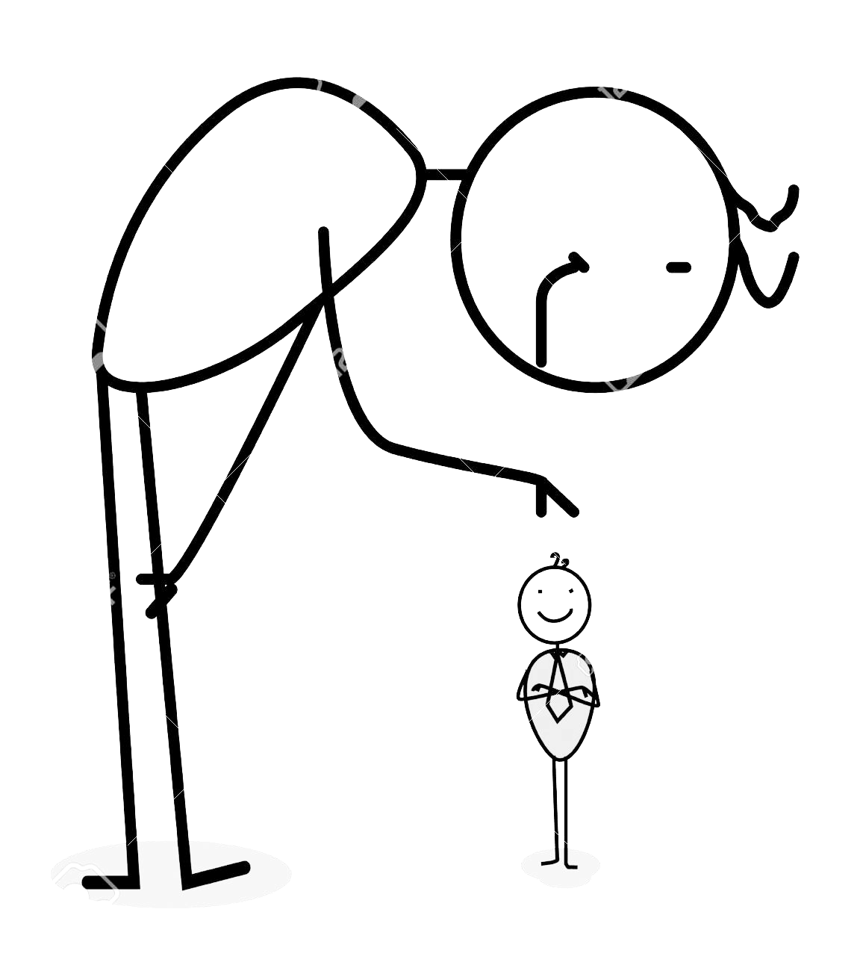
Today's fact:
Little endian and Big endian
Geek Corner "Fun" facts for geeks
The "endianness" in plain words is how the data is stored in the memory
Is how a sequence of bytes are stored in memory
In the "little endian" approach, the least significant byte is stored in the smallest address
In the "big endian" approach the most significant byte is stored in the smallest address

Slide 141
Today's fact:
Little endian and Big endian
Geek Corner
Each memory address can only hold a byte
So for example, if we want to store a 32 bit value, this will be divided in 4 bytes (one byte for each memory address):
In which order this bytes will be stored? Depending of the endianess
90 | AB | 12 | CD
Big endian
Little endian
90 | AB | 12 | CD
0x1000 | 0x1001 | 0x1002 | 0x1003
CD | 12 | AB | 90
0x1000 | 0x1001 | 0x1002 | 0x1003

Slide 142
Today's fact:
Little endian and Big endian
Geek Corner
Why this mess happened?!
Back in the old days where the chip technology was very limited, some manufacturers go with one or other endianness for simplicity
Old practices still carried today
Why this matters to me?
If you exchange data between devices, you may have to do transformations on the bytes, so the receiver can understand the sent message

Slide 143
Today's fact:
Little endian and Big endian
Geek Corner
Is there an easy way to know what kind of endianness has my machine?
1 2 3 4 5 6 7 8 9 10 11 12 13 | #include<iostream> #include <stdlib.h> using namespace std; int main() { unsigned int i = 1; char *c = (char*)&i; if(*c) cout << "Little endian" << endl; else cout << "Big endian" << endl; return 0; }

Slide 144

Today's fact:
Little endian and Big endian
Geek Corner
Why is called endianness? This term is taken of a satirical novel that mocks of trivial discussions among people such as:
Where to crack an egg? At the small end? At the big end?

Slide 145
Memory management
CE-2101 Algorithms and Data Structures

